Slide 1
2023 Report to the People Anderson County Cooperative Extension Service
Alex Butler – Agriculture and Natural Resources
Susan Campbell – 4-H and Youth Development

Slide 2
Agriculture and Natural Resources
Beef Quality and Care Assurance Chute Side Training
Number of producers participating: 42
Number of BQCA Certifications: 27
Training Location: David Dennis & Eric Phillips Farm – Lawrenceburg, KY
Date: Sept. 29th, 2022
Organization Partnerships: Kentucky Beef Network, Anderson County Cattlemen’s Association, Central Kentucky Ag Credit, Kentucky Livestock Marketing Association.

Slide 3
Beef Quality and Care Assurance – Chute Side Training
For several years the Kentucky Beef Network and its partners have provided Beef Quality and Care Assurance (BQCA) training for producers around Kentucky. The mission of BQCA is to maximize consumer confidence in and acceptance of beef by focusing the producer’s attention on daily production practices that influence safety, wholesome, and quality beef and beef products through the use of science, research, and education initiatives. BQCA training must be completed every three years by producers to maintain their certification. Anderson County Extension partnered with the Kentucky Beed Network, Kentucky Livestock Marketing Association, Kentucky Ag Development Fund, and University Specialists to provide hands-on chute side training. The County Agriculture Agent, Alex Butler, as well as KBN Field Associate Jacob Settles, taught the 4-hour training.
Though there has been a number of BQCA training conducted in the past, this was Anderson County’s first Chute-Side training. The training gave producers a hands-on learning experience that covered genetics, handling and facilities, health and management, body condition score, calving, end product, and economics. Producers were broken up into two groups where one group learned chute-side, and the other learned in a classroom setting. The groups were asked to switch midway through. Anderson County is going to continue to provide chute-side BQCA training on an every-other-year basis to give area producers the education resources they need. The program will switch farm locations to show producers the variability in operation and how to think critically about better meeting the needs of their cattle.

Slide 4
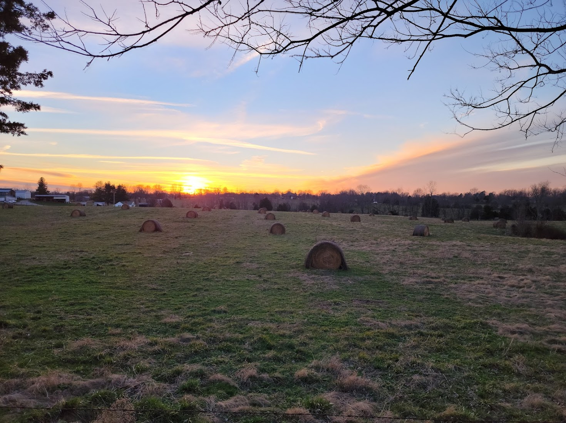
Agriculture and Natural Resources
Bale Grazing NRCS Grant
Number of Anderson Co. producers participating: 3
Number of States involved: 6
Money Allocated: $2.6 million

Slide 5
Bale Grazing – NRCS Grant
Hay feeding seasons in Kentucky can last anywhere from 90 days to 6 months, depending on several factors, including herd size, forage management, weather, and infrastructure. Shorter hay feeding seasons can give producers advantages in terms of production efficiency and input cost reduction. The Extension Agent, in partnership with specialists in Agricultural Economics, Animal Science, and Plant and Soil Sciences, has led a bale grazing trial with 4 Producers in Anderson County. Bale grazing is a winter-feeding method where bales are set out on pasture and fed in a planned, controlled manner, somewhat like rotational grazing.
The University of Kentucky recently received a $2.6 million Natural Resources Conservation Service (NRCS) On-Farm Conservation Innovation Grant to expand the project across six states: Kentucky, West Virginia, Virginia, North Carolina, New York, and Missouri. Continued field days and educational programs will occur with discoveries stemming from the research conducted for this grant.
Participants will be given written surveys multiple times in the coming year for both the Anderson County Extension Office as well as the University and NRCS. All producers verbally reported several outcomes that have spurred interest in the community by other producers. Shortened hay feeding season, less dependence on commercial fertilizer, and reduced input cost from decreased tractor usage were some of the most important metrics mentioned about the program.

Slide 6
Family & Consumer Sciences
39 Number of people who attended training on food safety, food handling, food processing, liability, and/or marketing.
10 Number of program participants reporting adoption of physical activity practices
23 Number of individuals who reported increased knowledge, skills, or intentions related to using the nutrition facts label

Slide 7
Mastering Food Choices
Like many rural communities, Anderson County faces chronic health disparities at greater rates than urban counterparts. Many of these health challenges are exacerbated by poor food environments and from a lack of knowledge and skills related to nutritious food choices in a variety of food settings. In efforts to address these health disparities, the Family and Consumer Sciences Agent initiated the six-session program Mastering Food Choices with 12 female adults over the age of 60 and one male. In lesson one, emphasis was placed on understanding the food environment of the county and how that impacts food choices as well as building knowledge needed to make healthier food choices in subsequent lessons.
The program was very well received by participants. On a scale of 1-4 with 4 being strongly agree, participants believed the subject matter was timely (3.3), speaker was effective (3.5), information was practical (3.6), the information is useful for their family (3.4), and the program was very educational (3.5). As a result of the lesson, 75% of the participants shared they were better able to identify food components that should be limited in the diet. 33% of participants shared they were better able to use the nutrition facts label to compare items and 25% better understand what their own food environment looks like. Further, 92% reported intentions to read nutrition facts labels or that they already did. 50% reported the intention to use online resources for determining nutrition information and 50% shared they intended to check nutrition information before dining out. Lack of a computer was cited as a barrier to these behaviors. Overall, 83% of participants felt the information they learned provided them the ability to make healthy food choices.
Participants shared they would use labels on food items to look for added sugar and sodium, they better understood the difference between saturated fat and trans fat, and were encouraged to read labels more often. Participants were also highly appreciative of the provided recipes.

Slide 8
4-H Teen Conference
The 98th Annual Kentucky 4-H Teen Conference was held at the University of Kentucky June 14-17, 2022. The objectives of Kentucky 4-H Teen Conference are: develop leadership and teamwork skills, improve communication skills, foster civic engagement, expand knowledge and skills related to 4-H core content areas, gain club, county and state 4-H program skills, have fun, create a sense of belonging, expand social skills through networking, develop youth-adult partnerships, and become acquainted with the University of Kentucky to aid in college and career readiness of Kentucky 4-H’ers.
During the educational experience all youth participated in a UK recruitment session with the Office of Enrollment Management. Additionally, they received academic exploration materials from the College of Agriculture, Food and Environment Center for Student Success. This exposure provided youth the opportunity to see what the University of Kentucky has to offer and begin the conversation about their potential to attend the University of Kentucky as a student.

Slide 9
Winter Leadership Workshop
Youth that is engaged in extracurricular activities more likely to become productive citizens in their community. After nearly 2 years of not being able to meet in person youth and parents have been eager to begin programming again. Youth in grades 9-12 are invited to participate and we have over twenty five teens enrolled in this group. During the year the teens had the opportunity to volunteer with 4-H programs designed for younger members, participate in the communications contest, and conduct meetings with parliamentary procedure to decide on activities the group would participate in. Our teens have also been engaged in the community with service learning projects. Four of the members serve on the district four teen council. Our teen group also planned a county leadership boot camp day in which they focused on communications and leadership skills.

Slide 10
4-H Youth Development
585 Number of youth who demonstrated a skill that was learned or improved by participating in 4-H natural resource programming
132 The number of youth who participated in overnight, 4-H summer camp
580 Number of youth who were educated on health and well-being through 4-H programs

Slide 11
Anderson County Cooperative Extension Service
Thank You!

